Slide 1

Karger’s algorithm for Minimum Cut
Dhanush Krishna R AM.EN.U4AIE20021
Pranav Jayasankar Nair AM.EN.U4AIE20056

Slide 2
Work Split up
Name | Work
Dhanush Krishna R | Karger’s Algorithm
Pranav Jayasankar Nair | Karger-Stein Algorithm

Slide 3
Problem Statement
Given an undirected and unweighted graph, find the smallest cut ie smallest number of edges that disconnects the graph into two components.

Slide 4
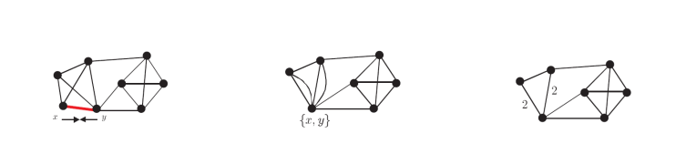
Karger’s Algorithm
In a graph G, contraction of edge e with endpoints u, v is the replacement of u and v with single vertex whose incident edges are the edges other than e that were incident to u or v. the resulting graph, denoted as G/e.

Slide 5
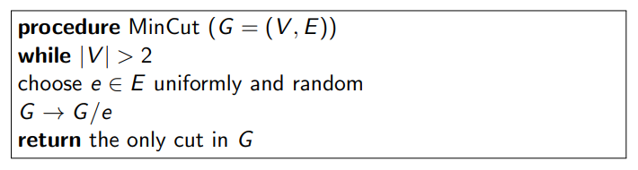
Algorithm

Slide 6
Observation
The size of the minimum cut in G/e is at least as large as the minimum cut in G (as long as G/e has at least one edge). Since any cut in G/e has a corresponding cut of the same cardinality in G.
Let e1, ...en−2 be a sequence of edges in G, such that none of them is in the minimum cut, and such that G’= G/e1, ...en−2 is a single multi-edge. Then, this multi-edge correspond to the minimum cut in G.
The algorithm always output a cut, and the cut is not smaller than the minimum cut.

Slide 7
Analysis of Algorithm
A cut (S,T) is output by the MinCut algorithm if and only if no edge crossing (S,T) is contracted by the algorithm.
If a graph G has a minimum cut of size k, and it has n vertices, then |E(G)| ≥ (k*n)/ 2
If we pick in random an edge e from a graph G, then with probability at most 2/n it belong to the minimum cut.
MinCut algorithm runs in O(n^2 ) time.

Slide 8
MinCut algorithm outputs the min cut in probability P ≥ 2/n(n−1)
The probability that repeat MinCut algorithm T = (nC2)* log(n) times fails to return the minimum cut is < 1/n
In O(n^4 log(n)) time the minimum cut is returned with high probability.

Slide 9
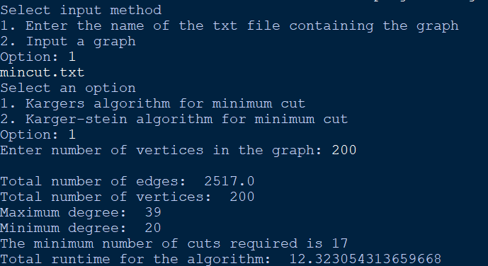
Input and output

Slide 10
Karger-Stein Algorithm
During the sequence of edge contractions, the probability of choosing right edges is high at the beginning but low later since there are small number of vertices left. The Karger-Stein algorithm uses the general framework of that in the Karger’s mincut algorithm but runs the “later” part more times. Suppose we contract edges from n vertices to l vertices twice. We can choose l to have the probability of success is about 1/2 . So in expectation, one of the two runs work. Then we recurse each of these bifurcates. Take best of two, then pop back up from the recursion

Slide 11
The probability that MinCut(G, n/ √ 2) had NOT contracted the minimum cut is at least 1/2.

Slide 12
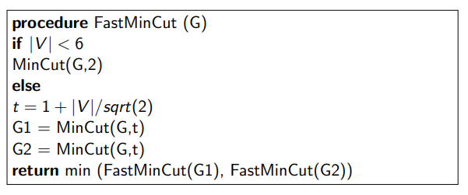
Algorithm

Slide 13
Analysis
The running time of FastMinCut(G) is O(n^2 log(n)), where n = |V(G)|.
Well, we perform two calls to MinCut(G,t) which takes O(n^2 ) time. And then we perform two recursive calls, on the resulting graphs.
We have: T(n) = O(n^2 ) + 2T( n/ √ 2 ) The solution to this recurrence is O(n^2 log (n)) as one can easily verify.

Slide 14
Running FastMinCut finds the minimum cut with probability larger that 2*log (2) /log n ,which can be notated as Ω(1/ log n)
With high probability we can find all min cuts in the running time of O(n^2 log^3(n)).

Slide 15
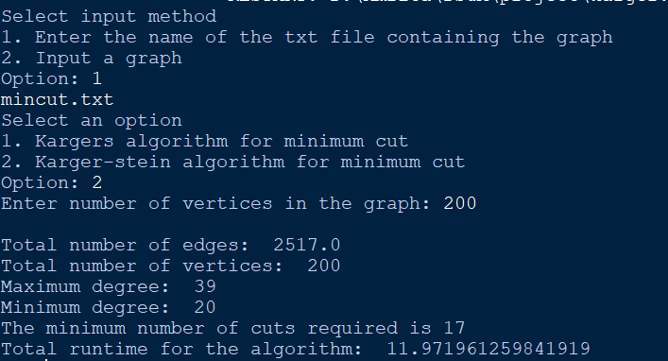
Input and output

Slide 16
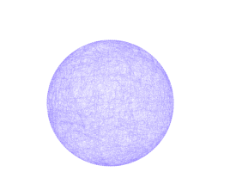
Example (for both algorithms)
Total edges: 2517
Total vertices: 200
Maximum degree: 39
Minimum degree: 20
Average degree: 25
Mincut is 17

Slide 17
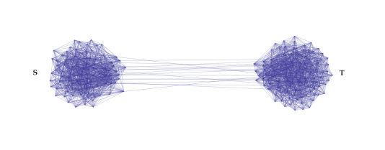
The number of edges between vertex set (S,T) is 17.

Slide 18
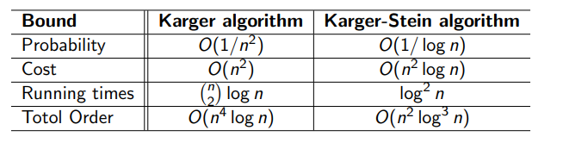
Comparison between Karger and Karger Stein algorithm

